Slide 1
Musicfy Final Presentation
by Sammil Panda, Pariben Mehta, Luis Serrano

Slide 2
Welcome to Musicfy
Introduction
Musicfy is a music-sharing social media app that allows users to post their favorite songs or playlists from platforms like Spotify, YouTube, and Apple Music.
Users can like, dislike, comment, and share music posts, encouraging community engagement and discovery.
The app aims to bridge the gap between music streaming and social interaction offering a dedicated space for musical expression and exploration.
By integrating with popular streaming services, Musicfy creates a seamless experience for music lovers to connect and express their tastes.
Our goal: Make music discovery personal, social, and fun.

Slide 3
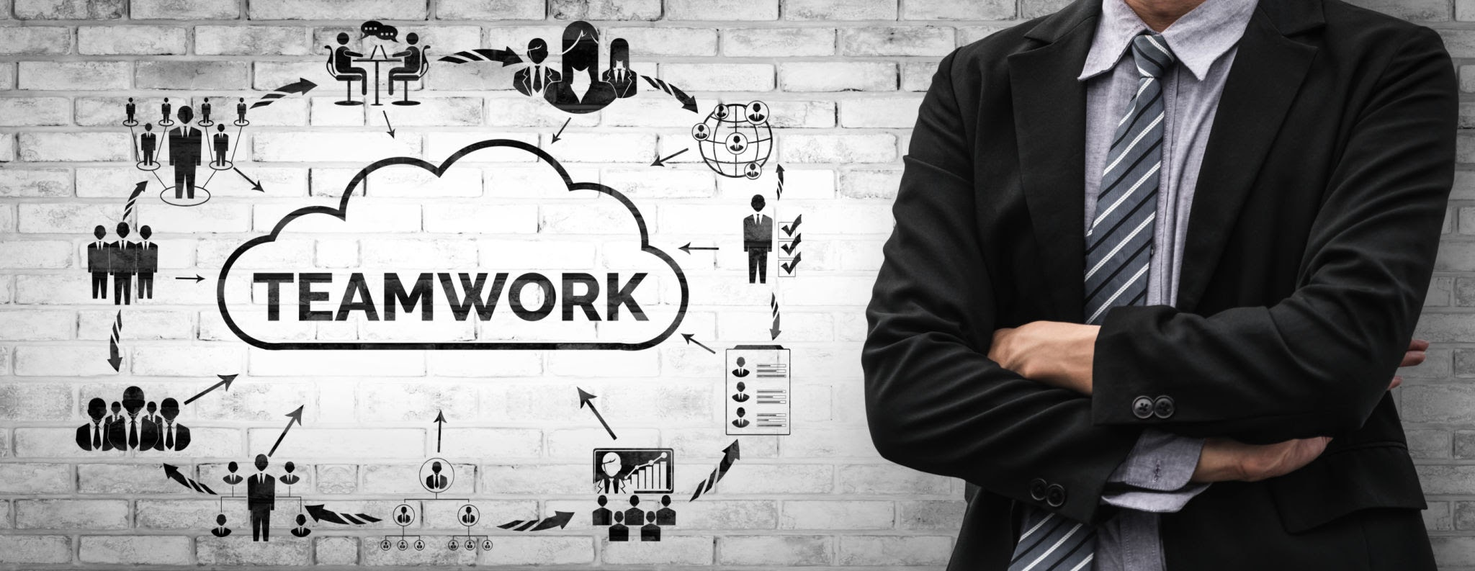
Team Roles
Luis Serrano
Contributed to project planning, documentation, and quality assurance
Worked on use case diagram/description development and sequence diagrams
Sammil Panda
Contributed to project planning, documentation, and quality assurance
Contributed to system context and design-level class diagram models
Pariben Mehta
Contributed to project planning, documentation, and quality assurance
Created the statechart, normal class diagram and contributed to future planning
Note:
Team leadership was rotated throughout the semester
All members participated in planning and coordination

Slide 4
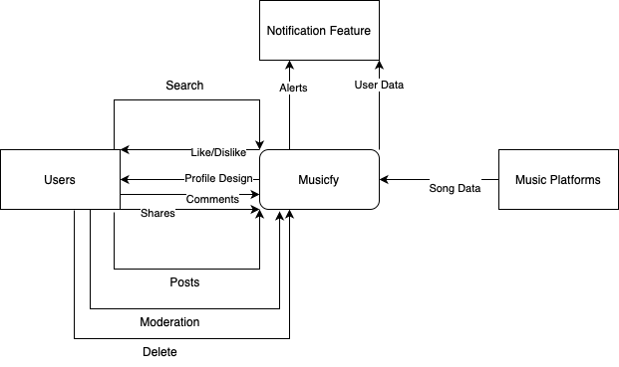
System Context

Slide 5
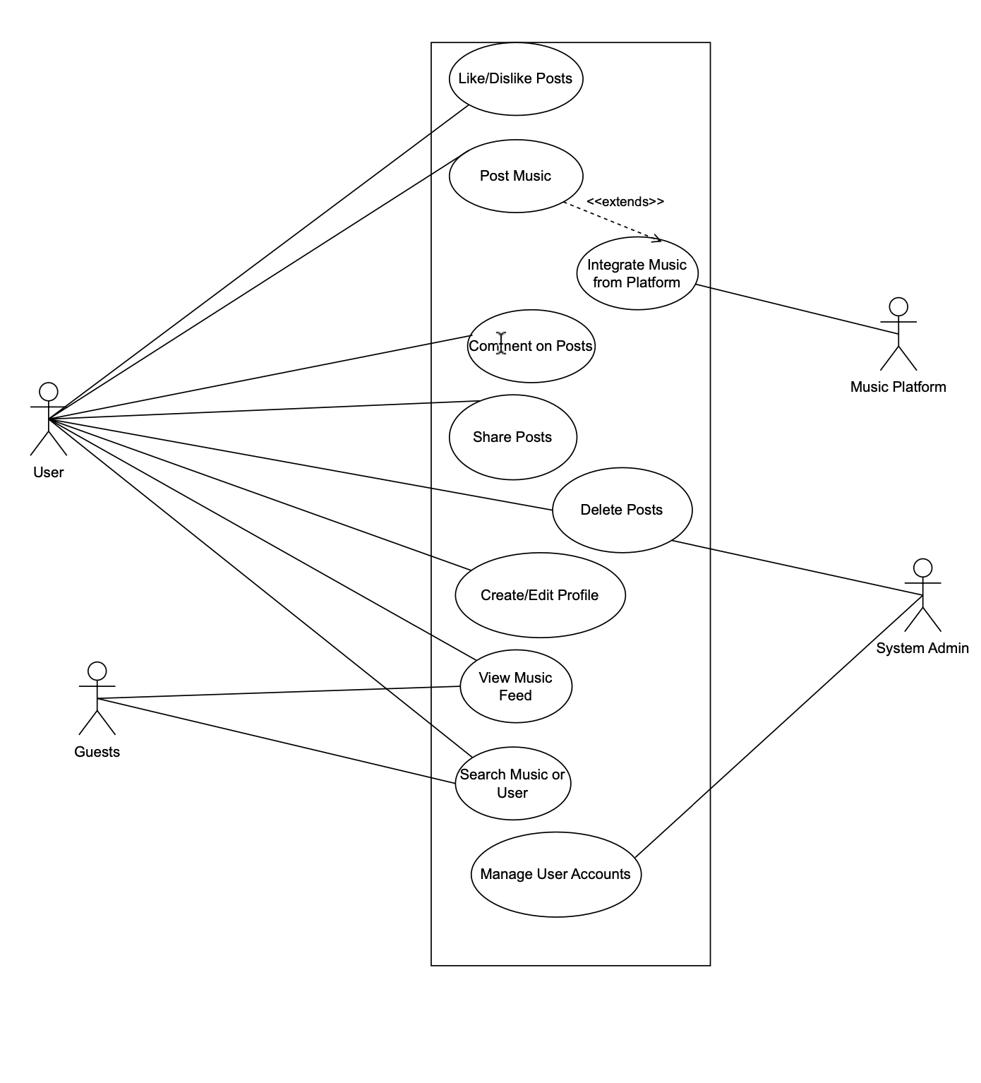
Use Case + Descriptions

Slide 6
Use Case Description Examples
Use Case 2: Post Music
Actor: User
Precondition: User is logged in and has a valid music link from Spotify, YouTube, or Apple Music. Music can also be uploaded.
Main Flow:
User clicks “Post Music.”
Pastes a link and optionally adds a caption.
Submits the post.
Postcondition: Post appears in the user’s profile and community feed.
Use Case 3: Comment on Posts
Actor: User
Precondition: User is logged in and viewing a specific post.
Main Flow:
User selects “Comment,” types a message, and submits it.
Postcondition: Comment is visible beneath the post.
Use Case 1: Like/Dislike Posts
Actor: User
Precondition: User is logged into their account and viewing the music feed.
Main Flow:
User clicks the like or dislike icon on a post.
System updates the count for that reaction.
Postcondition: System records the input and displays the updated total.

Slide 7
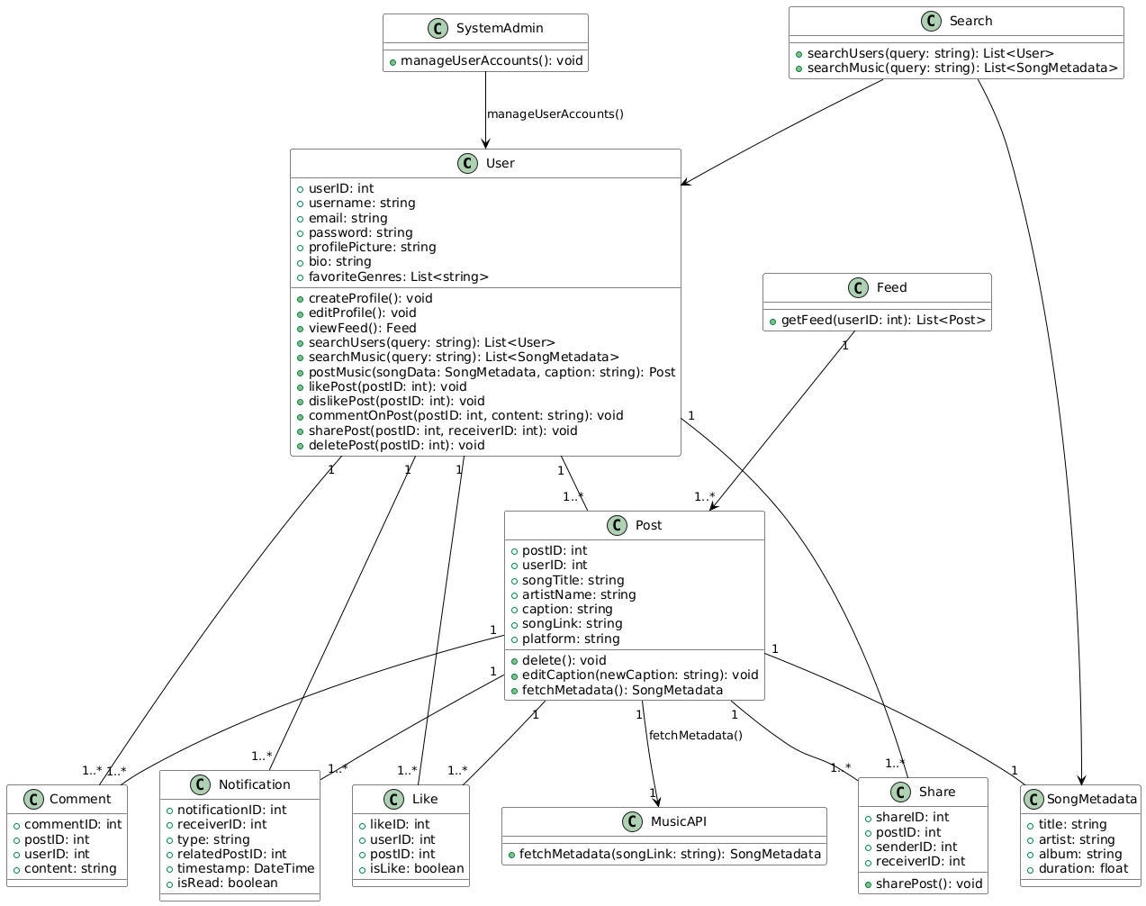
Class Diagram

Slide 8
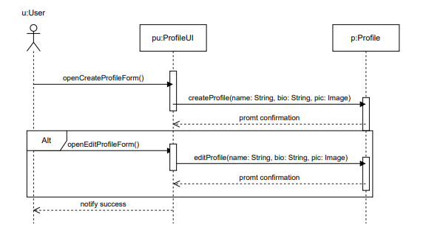
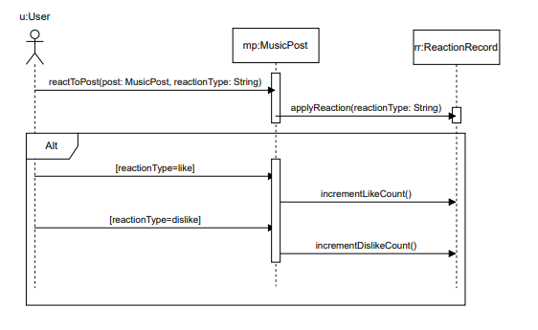
Sequence Diagrams

Slide 9
Other Activities
Communicated through Discord
Shared numbers to get more direct communication
Used Google, Microsoft, Draw.io to share docs, slides, and project work
Organized our documents in Github

Slide 10
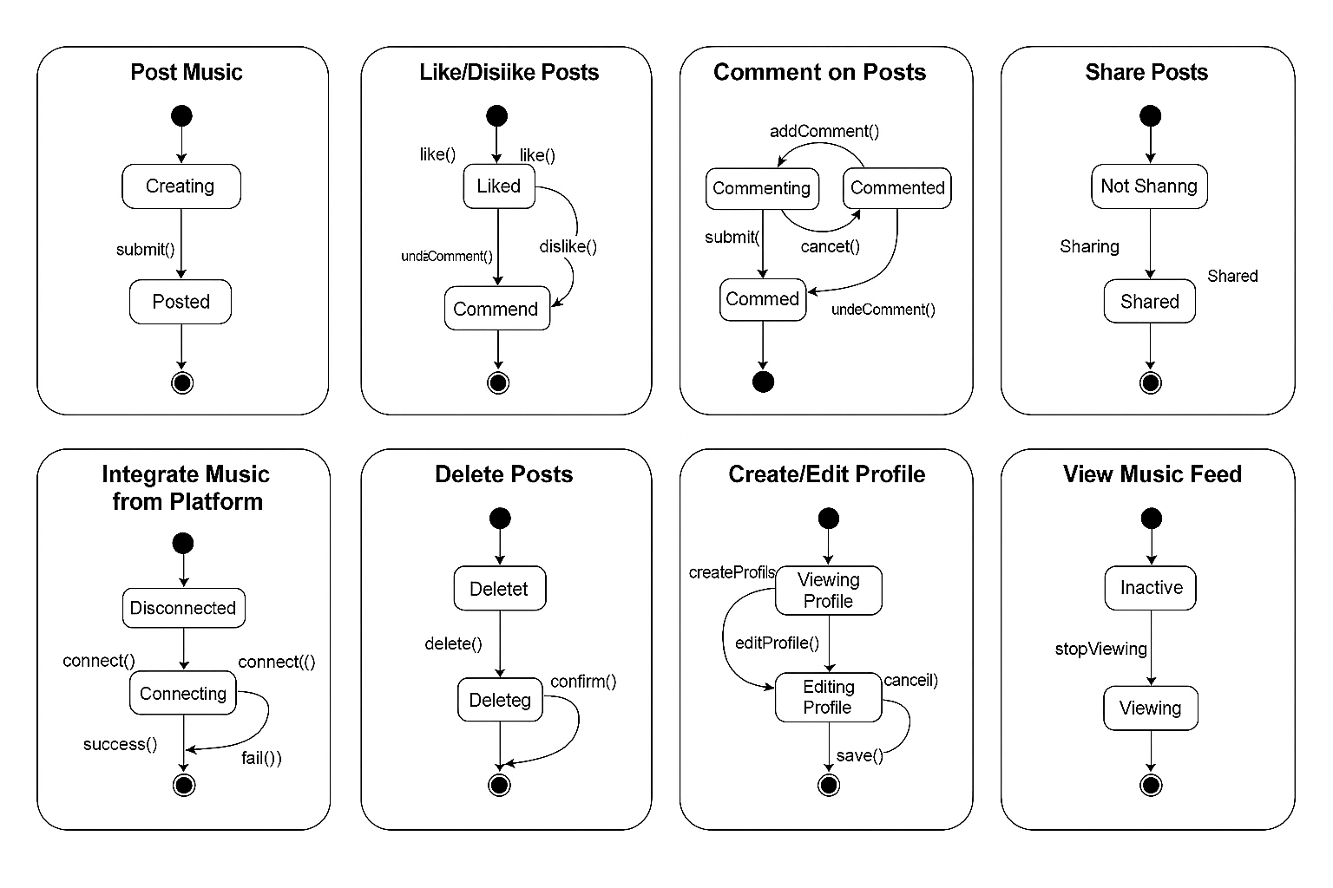
Statechart
undoCommend()()
undoComment()
canedit()

Slide 11
Whats Next?
Once all the charts and diagrams are done, the fun part begins actually building the app. This is where we take everything we planned, like the user interface designs, class diagrams, and system flows, and start turning it into real, working code. We split up the work, some of us focus on designing the screens and user experience, while others build the backend logic and connect everything with music platforms like Spotify and YouTube. It's kind of like putting together a puzzle, using all the pieces we designed earlier. We also start testing things as we go to make sure everything runs smoothly. This is the phase where our ideas finally come to life.

Slide 12
Goals/Lessons
Our main goal for this project was to create a music-sharing app that’s not only functional but also fun and social, something that brings together people’s love for music in one space. We wanted users to easily share songs from platforms like Spotify or YouTube, connect with others, and discover new music through a personalized feed. Along the way, we learned that turning an idea into a real working system takes a lot more than just coding, it takes planning, teamwork, and constant communication. We learned how to break big problems into smaller, manageable tasks, how to design systems that actually make sense, and how to stay organized under deadlines. One of the biggest takeaways was learning how important user feedback and clean design are because if users don’t enjoy using the app, the tech behind it won’t matter. Overall, this project taught us not just how to build something cool, but how to build it together.

